Slide 1
Prospective fault current
PowerPoint presentation
Unit 304: Electrical Installations: inspection, testing and commissioning

Slide 2
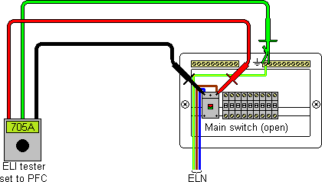
Prospective fault current
Prospective earth fault current (PFC)

Slide 3
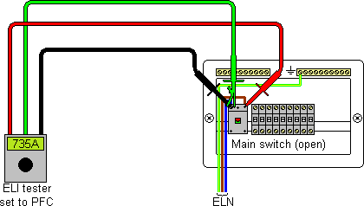
Prospective fault current
Prospective short-circuit current (PSC)

Slide 4
Prospective fault current
Prospective short-circuit current (PSC) – three phase
It can be assumed that for three phase supplies the maximum balanced prospective short circuit level will be, as a rule of thumb, approximately twice the single phase value.
This figure errs on the side of safety.

Slide 5
Prospective fault current
Rated short-circuit breaking capacities of protective devices
The values obtained should be compared with the breaking capacity of the appropriate protective device.
The breaking capacity of the protective device should be greater than the highest value of prospective fault current obtained using the instrument.

Slide 6
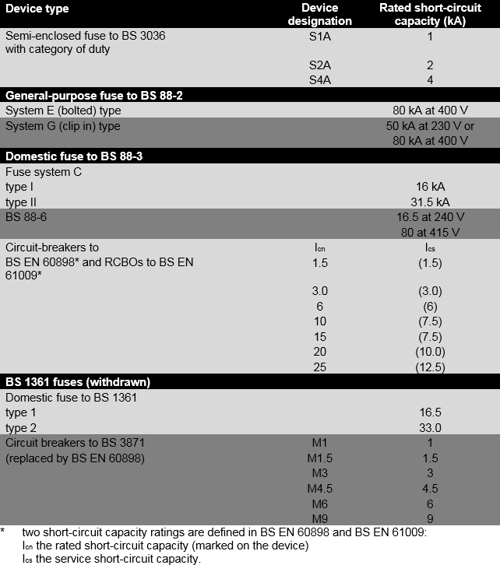

Slide 7
Any questions?

